Slide 1

Chapter 25
Domain Name System
25.<number>
Copyright © The McGraw-Hill Companies, Inc. Permission required for reproduction or display.

Slide 2
Domain Name System (DNS)
There are several applications in the application layer of the Internet model that follow the client/server paradigm.
The client/server programs can be divided into two categories: those that can be directly used by the user, such as e-mail, and those that support other application programs.
The Domain Name System (DNS) is a supporting program that is used by other programs such as e-mail.
25.<number>

Slide 3
Figure 25.1 shows an example of how a DNS client/server program can support an e-mail program to find the IP address of an e-mail recipient.
A user of an e-mail program may know the e-mail address of the recipient; however, the IP protocol needs the IP address.
The DNS client program sends a request to a DNS server to map the e-mail address to the corresponding IP address.
To identify an entity, TCP/IP protocols use the IP address, which uniquely identifies the connection of a host to the Internet.
However, people prefer to use names instead of numeric addresses. Therefore, we need a system that can map a name to an address or an address to a name.
When the Internet was small, mapping was done by using a host file.
The host file had only two columns: name and address.
Every host could store the host file on its disk and update it periodically from a master host file. When a program or a user wanted to map a name to an address, the host consulted the host file and found the mapping.
25.<number>

Slide 4

Figure 25.1 Example of using the DNS service
25.<number>

Slide 5
Today, however, it is impossible to have one single host file to relate every address with a name and vice versa.
The host file would be too large to store in every host. In addition, it would be impossible to update all the host files every time there was a change.
One solution would be to store the entire host file in a single computer and allow access to this centralized information to every computer that needs mapping. But we know that this would create a huge amount of traffic on the Internet.
Another solution, the one used today, is to divide this huge amount of information into smaller parts and store each part on a different computer.
In this method, the host that needs mapping can contact the closest computer holding the needed information. This method is used by the Domain Name System (DNS).
25.<number>

Slide 6
25-1 NAME SPACE
To be unambiguous, the names assigned to machines must be carefully selected from a name space with complete control over the binding between the names and IP addresses.
In other words, the names must be unique because the addresses are unique.
A name space that maps each address to a unique name can be organized in two ways: flat or hierarchical.
Topics discussed in this section:
Flat Name Space
Hierarchical Name Space
25.<number>

Slide 7
Flat Name Space
In a flat name space, a name is assigned to an address.
A name in this space is a sequence of characters without structure.
The names may or may not have a common section; if they do, it has no meaning.
The main disadvantage of a flat name space is that it cannot be used in a large system such as the Internet because it must be centrally controlled to avoid ambiguity and duplication.
25.<number>

Slide 8
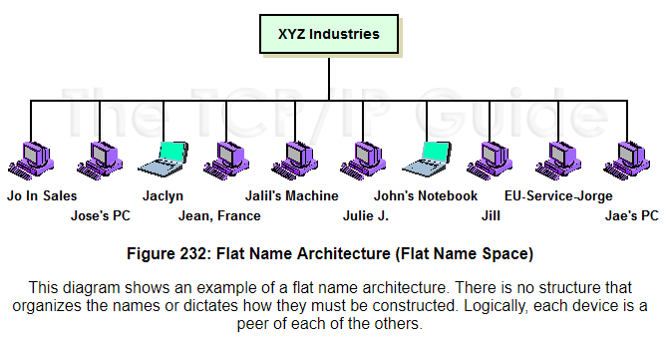
Names are assigned as a sequence of symbols that are interpreted as a single, whole label without any internal structure. There is no clear relationship between any name and any other name.
An example of this sort of architecture would be a name system where computers are given unstructured names like “Engineering Workstation 1” or “Joanne's PC”, as shown in the example in Figure 232.
25.<number>

Slide 9
Hierarchical Name Space
In a hierarchical name space, each name is made of several parts.
The first part can define the nature of the organization, the second part can define the name of an organization, the third part can define departments in the organization, and so on.
In this case, the authority to assign and control the name spaces can be decentralized.
A central authority can assign the part of the name that defines the nature of the organization and the name of the organization.
The responsibility of the rest of the name can be given to the organization itself.
The organization can add suffixes (or prefixes) to the name to define its host or resources.
The management of the organization need not worry that the prefix chosen for a host is taken by another organization because, even if part of an address is the same, the whole address is different.
25.<number>

Slide 10
For example, assume two colleges and a company call one of their computers challenger.
The first college is given a name by the central authority such as jhda.edu, the second college is given the name berkeley.edu, and the company is given the name smart. com.
When these organizations add the name challenger to the name they have already been given, the end result is three distinguishable names: challenger.jhda.edu, challenger.berkeley.edu, and challenger.smart.com.
The names are unique without the need for assignment by a central authority.
The central authority controls only part of the name, not the whole.
25.<number>

Slide 11
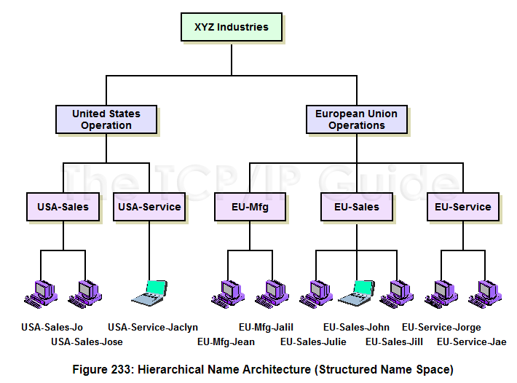
25.<number>

Slide 12
25-2 DOMAIN NAME SPACE
To have a hierarchical name space, a domain name space was designed. In this design the names are defined in an inverted-tree structure with the root at the top. The tree can have only 128 levels: level 0 (root) to level 127.
Topics discussed in this section:
Label
Domain Name
Domain
25.<number>

Slide 13

Figure 25.2 Domain name space
25.<number>

Slide 14
Label
Each node in the tree has a label, which is a string with a maximum of 63 characters.
The root label is a null string (empty string).
DNS requires that children of a node (nodes that branch from the same node) have different labels, which guarantees the uniqueness of the domain names.
25.<number>

Slide 15
Domain Name
Each node in the tree has a domain name.
A full domain name is a sequence of labels separated by dots (.).
The domain names are always read from the node up to the root.
The last label is the label of the root (null). This means that a full domain name always ends in a null label, which means the last character is a dot because the null string is nothing.
Figure 25.3 shows some domain names.
25.<number>

Slide 16

Figure 25.3 Domain names and labels
25.<number>

Slide 17
Fully Qualified Domain Name
If a label is terminated by a null string, it is called a fully qualified domain name (FQDN).
An FQDN is a domain name that contains the full name of a host. It contains all labels, from the most specific to the most general, that uniquely define the name of the host.
For example, the domain name
challenger.ate.tbda.edu.
is the FQDN of a computer named challenger installed at the Advanced Technology Center (ATC) at De Anza College.
A DNS server can only match an FQDN to an address.
Note that the name must end with a null label, but because null means nothing, the label ends with a dot (.).
25.<number>

Slide 18
Partially Qualified Domain Name
If a label is not terminated by a null string, it is called a partially qualified domain name (PQDN).
A PQDN starts from a node, but it does not reach the root.
It is used when the name to be resolved belongs to the same site as the client. Here the resolver can supply the missing part, called the suffix, to create an FQDN.
For example, if a user at the jhda.edu. site wants to get the IP address of the challenger computer, he or she can define the partial name challenger
The DNS client adds the suffix atc.jhda.edu. before passing the address to the DNS server.
The DNS client normally holds a list of suffixes.
The following can be the list of suffixes at De Anza College. The null suffix defines nothing. This suffix is added when the user defines an FQDN.
atc.fhda.edu
fhda.edu
null
25.<number>

Slide 19

Figure 25.4 FQDN and PQDN
25.<number>

Slide 20
Domain
A domain is a subtree of the domain name space.
The name of the domain is the domain name of the node at the top of the subtree.
Figure 25.5 shows some domains.
Note that a domain may itself be divided into domains (or subdomains as they are sometimes called).
25.<number>

Slide 21

Figure 25.5 Domains
25.<number>

Slide 22
25-3 DISTRIBUTION OF NAME SPACE
The information contained in the domain name space must be stored. However, it is very inefficient and also unreliable to have just one computer store such a huge amount of information. In this section, we discuss the distribution of the domain name space.
Topics discussed in this section:
Hierarchy of Name Servers
Zone
Root Server
Primary and Secondary Servers
25.<number>

Slide 23
Hierarchy of Name Servers
The solution to these problems is to distribute the information among many computers called DNS servers.
One way to do this is to divide the whole space into many domains based on the first level.
In other words, we let the root stand alone and create as many domains (subtrees) as there are first-level nodes.
Because a domain created in this way could be very large, DNS allows domains to be divided further into smaller domains (subdomains).
Each server can be responsible (authoritative) for either a large or a small domain.
In other words, we have a hierarchy of servers in the same way that we have a hierarchy of names (see Figure 25.6).
25.<number>

Slide 24

Figure 25.6 Hierarchy of name servers
25.<number>

Slide 25
Zone
Since the complete domain name hierarchy cannot be stored on a single server, it is divided among many servers. What a server is responsible for or has authority over is called a zone.
We can define a zone as a contiguous part of the entire tree.
If a server accepts responsibility for a domain and does not divide the domain into smaller domains, the domain and the zone refer to the same thing.
The server makes a database called a zone file and keeps all the information for every node under that domain.
However, if a server divides its domain into subdomains and delegates part of its authority to other servers, domain and zone refer to different things.
The information about the nodes in the subdomains is stored in the servers at the lower levels, with the original server keeping some sort of reference to these lower-level servers. Of course the original server does not free itself from responsibility totally: It still has a zone, but the detailed information is kept by the lower-level servers (see Figure 25.7).
A server can also divide part of its domain and delegate responsibility but still keep part of the domain for itself. In this case, its zone is made of detailed information for the part of the domain that is not delegated and references to those parts that are delegated.
25.<number>

Slide 26

Figure 25.7 Zones and domains
25.<number>

Slide 27
Root Server
A root server is a server whose zone consists of the whole tree.
A root server usually does not store any information about domains but delegates its authority to other servers, keeping references to those servers.
There are several root servers, each covering the whole domain name space. The servers are distributed all around the world.
25.<number>

Slide 28
Primary and Secondary Servers
DNS defines two types of servers: primary and secondary.
A primary server is a server that stores a file about the zone for which it is an authority. It is responsible for creating, maintaining, and updating the zone file. It stores the zone file on a local disk.
A secondary server is a server that transfers the complete information about a zone from another server (primary or secondary) and stores the file on its local disk. The secondary server neither creates nor updates the zone files. If updating is required, it must be done by the primary server, which sends the updated version to the secondary.
The primary and secondary servers are both authoritative for the zones they serve.
The idea is not to put the secondary server at a lower level of authority but to create redundancy for the data so that if one server fails, the other can continue serving clients.
Note also that a server can be a primary server for a specific zone and a secondary server for another zone. Therefore, when we refer to a server as a primary or secondary server, we should be careful to which zone we refer.
25.<number>

Slide 29

Note
A primary server loads all information from the disk file; the secondary server
loads all information from
the primary server.
When the secondary downloads
information from the primary, it is called zone transfer.
25.<number>

Slide 30
25-4 DNS IN THE INTERNET
DNS is a protocol that can be used in different platforms. In the Internet, the domain name space (tree) is divided into three different sections: generic domains, country domains, and the inverse domain.
Topics discussed in this section:
Generic Domains
Country Domains
Inverse Domain
25.<number>

Slide 31

Figure 25.8 DNS IN THE INTERNET
25.<number>

Slide 32
Generic Domains
The generic domains define registered hosts according to their generic behavior.
Each node in the tree defines a domain, which is an index to the domain name space database (see Figure 25.9).
25.<number>

Slide 33

Figure 25.9 Generic domains
25.<number>

Slide 34

Looking at the tree, we see that the first level in the generic domains section allows 14 possible labels. These labels describe the organization types as listed in Table 25.1.
Table 25.1 Generic domain labels
25.<number>

Slide 35
Country Domains
The country domains section uses two-character country abbreviations (e.g., us for United States).
Second labels can be organizational, or they can be more specific, national designations. The United States, for example, uses state abbreviations as a subdivision of us (e.g., ca.us.).
Figure 25.10 shows the country domains section.
The address anza.cup.ca.us can be translated to De Anza College in Cupertino, California, in the United States.
25.<number>

Slide 36

Figure 25.10 Country domains
25.<number>

Slide 37
Inverse Domain
The inverse domain is used to map an address to a name.
This may happen, for example, when a server has received a request from a client to do a task.
Although the server has a file that contains a list of authorized clients, only the IP address of the client (extracted from the received IP packet) is listed.
The server asks its resolver to send a query to the DNS server to map an address to a name to determine if the client is on the authorized list. This type of query is called an inverse or pointer (PTR) query.
To handle a pointer query, the inverse domain is added to the domain name space with the first-level node called arpa (for historical reasons).
The second level is also one single node named in-addr (for inverse address).
The rest of the domain defines IP addresses.
25.<number>

Slide 38
The servers that handle the inverse domain are also hierarchical. This means the netid part of the address should be at a higher level than the subnetid part, and the subnetid part higher than the hostid part.
In this way, a server serving the whole site is at a higher level than the servers serving each subnet. This configuration makes the domain look inverted when compared to a generic or country domain.
To follow the convention of reading the domain labels from the bottom to the top, an IP address such as 132.34.45.121 (a class B address with netid 132.34) is read as 121.45.34.132.in-addr. arpa.
See Figure 25.11 for an illustration of the inverse domain configuration.
25.<number>

Slide 39

Figure 25.11 Inverse domain
25.<number>

Slide 40
25-5 RESOLUTION
Mapping a name to an address or an address to a name is called name-address resolution.
Topics discussed in this section:
Resolver
Mapping Names to Addresses
Mapping Addresses to Names
Recursive Resolution
Caching
25.<number>

Slide 41
Resolver
DNS is designed as a client/server application.
A host that needs to map an address to a name or a name to an address calls a DNS client called a resolver.
The resolver accesses the closest DNS server with a mapping request. If the server has the information, it satisfies the resolver; otherwise, it either refers the resolver to other servers or asks other servers to provide the information.
After the resolver receives the mapping, it interprets the response to see if it is a real resolution or an error, and finally delivers the result to the process that requested it.
25.<number>

Slide 42
Mapping Names to Addresses
Most of the time, the resolver gives a domain name to the server and asks for the corresponding address.
In this case, the server checks the generic domains or the country domains to find the mapping.
If the domain name is from the generic domains section, the resolver receives a domain name such as "chal.atc.jhda.edu.".
The query is sent by the resolver to the local DNS server for resolution.
If the local server cannot resolve the query, it either refers the resolver to other servers or asks other servers directly.
If the domain name is from the country domains section, the resolver receives a domain name such as "ch.jhda.cu.ca.us.". The procedure is the same.
25.<number>

Slide 43
Mapping Addresses to Names
A client can send an IP address to a server to be mapped to a domain name, this is called a PTR query.
To answer queries of this kind, DNS uses the inverse domain.
However, in the request, the IP address is reversed and the two labels in-addr and arpa are appended to create a domain acceptable by the inverse domain section.
For example, if the resolver receives the IF address 132.34.45.121, the resolver first inverts the address and then adds the two labels before sending.
The domain name sent is "121.45.34.132.in-addr.arpa." which is received by the local DNS and resolved.
25.<number>

Slide 44
Recursive Resolution
The client (resolver) can ask for a recursive answer from a name server. This means that the resolver expects the server to supply the final answer.
If the server is the authority for the domain name, it checks its database and responds.
If the server is not the authority, it sends the request to another server (the parent usually) and waits for the response.
If the parent is the authority, it responds; otherwise, it sends the query to yet another server.
When the query is finally resolved, the response travels back until it finally reaches the requesting client. This is called recursive resolution and is shown in Figure 25.12.
25.<number>

Slide 45

Figure 25.12 Recursive resolution
25.<number>

Slide 46
Iterative Resolution
If the client does not ask for a recursive answer, the mapping can be done iteratively.
If the server is an authority for the name, it sends the answer.
If it is not, it returns (to the client) the IP address of the server that it thinks can resolve the query.
The client is responsible for repeating the query to this second server.
If the newly addressed server can resolve the problem, it answers the query with the IP address; otherwise, it returns the IP address of a new server to the client.
Now the client must repeat the query to the third server. This process is called iterative resolution because the client repeats the same query to multiple servers.
In Figure 25.13 the client queries four servers before it gets an answer from the mcgraw.com server.
25.<number>

Slide 47

Figure 25.13 Iterative resolution
25.<number>

Slide 48
Caching
Each time a server receives a query for a name that is not in its domain, it needs to search its database for a server IP address.
Reduction of this search time would increase efficiency. DNS handles this with a mechanism called caching.
When a server asks for a mapping from another server and receives the response, it stores this information in its cache memory before sending it to the client.
If the same or another client asks for the same mapping, it can check its cache memory and solve the problem.
However, to inform the client that the response is coming from the cache memory and not from an authoritative source, the server marks the response as unauthoritative.
25.<number>

Slide 49
Caching speeds up resolution, but it can also be problematic.
If a server caches a mapping for a long time, it may send an outdated mapping to the client. To counter this, two techniques are used.
First, the authoritative server always adds information to the mapping called time-to-live (TTL). It defines the time in seconds that the receiving server can cache the information.
After that time, the mapping is invalid and any query must be sent again to the authoritative server. Second, DNS requires that each server keep a TTL counter for each mapping it caches.
The cache memory must be searched periodically, and those mappings with an expired TTL must be purged.
25.<number>

Slide 50
25-6 DNS MESSAGES
DNS has two types of messages: query and response. Both types have the same format. The query message consists of a header and question records; the response message consists of a header, question records, answer records, authoritative records, and additional records.
Topics discussed in this section:
Header
25.<number>

Slide 51
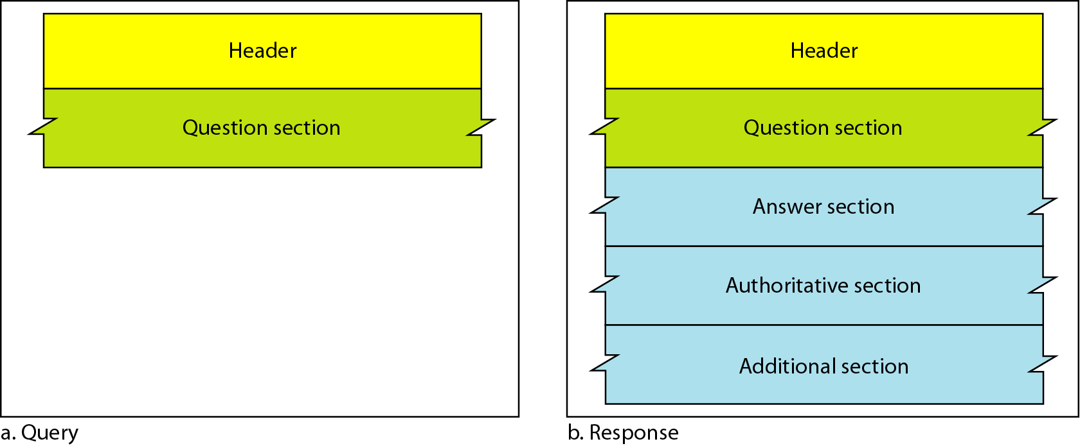
Figure 25.14 Query and response messages
25.<number>

Slide 52
Header
Both query and response messages have the same header format with some fields set to zero for the query messages.
The header is 12 bytes, and its format is shown in Figure 25.15.
25.<number>

Slide 53
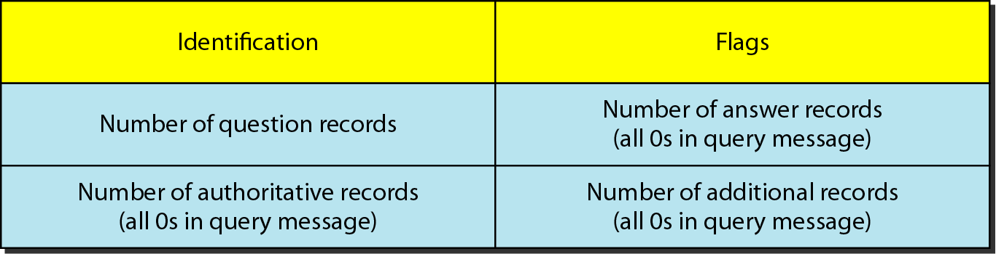
Figure 25.15 Header format
25.<number>

Slide 54
The identification subfield is used by the client to match the response with the query.
The client uses a different identification number each time it sends a query. The server duplicates this number in the corresponding response.
The flags subfield is a collection of subfields that define the type of the message, the type of answer requested, the type of desired resolution (recursive or iterative), and so on.
The number of question records subfield contains the number of queries in the question section of the message.
The number of answer records subfield contains the number of answer records in the answer section of the response message. Its value is zero in the query message.
The number of authoritative records subfield contains the number of authoritative records in the authoritative section of a response message. Its value is zero in the query message.
Finally, the number of additional records subfield contains the number additional records in the additional section of a response message. Its value is zero in the query message.
25.<number>

Slide 55
Question Section: This is a section consisting of one or more question records. It is present on both query and response messages.
Answer Section: This is a section consisting of one or more resource records. It is present only on response messages. This section includes the answer from the server to the client (resolver).
Authoritative Section :This is a section consisting of one or more resource records. It is present only on response messages. This section gives information (domain name) about one or more authoritative servers for the query.
Additional Information Section :This is a section consisting of one or more resource records. It is present only on response messages. This section provides additional information that may help the resolver.
For example, a server may give the domain name of an authoritative server to the resolver in the authoritative section, and include the IP address of the same authoritative server in the additional information section.
25.<number>

Slide 56
25-7 TYPES OF RECORDS
As we saw in Section 25.6, two types of records are used in DNS. The question records are used in the question section of the query and response messages. The resource records are used in the answer, authoritative, and additional information sections of the response message.
Topics discussed in this section:
Question Record
Resource Record
25.<number>

Slide 57
Question Record
A question record is used by the client to get information from a server. This contains the domain name.
- Resource Record
Each domain name (each node on the tree) is associated with a record called the resource record. The server database consists of resource records. Resource records are also what is returned by the server to the client.
25.<number>

Slide 58
25-8 REGISTRARS
How are new domains added to DNS? This is done through a registrar, a commercial entity accredited by ICANN. A registrar first verifies that the requested domain name is unique and then enters it into the DNS database. A fee is charged.
25.<number>

Slide 59
Today, there are many registrars; their names and addresses can be found at http://www.intenic.net
To register, the organization needs to give the name of its server and the IP address of the server.
For example, a new commercial organization named wonderful with a server named ws and IP address 200.200.200.5 needs to give the following information to one of the registrars:
Domain name: WS.wonderful.com
IP address: 200.200.200.5
25.<number>

Slide 60
25-9 DYNAMIC DOMAIN NAME
SYSTEM (DDNS)
The DNS master file must be updated dynamically. The Dynamic Domain Name System (DDNS) therefore was devised to respond to this need. In DDNS, when a binding between a name and an address is determined, the information is sent, usually by DHCP to a primary DNS server. The primary server updates the zone. The secondary servers are notified either actively or passively.
25.<number>

Slide 61
When the DNS was designed, no one predicted that there would be so many address changes. In DNS, when there is a change, such as adding a new host, removing a host, or changing an IP address, the change must be made to the DNS master file. These types of changes involve a lot of manual updating. The size of today's Internet does not allow for this kind of manual operation.
The DNS master file must be updated dynamically. The Dynamic Domain Name System (DDNS) therefore was devised to respond to this need. In DDNS, when a binding between a name and an address is determined, the information is sent, usually by DHCP to a primary DNS server. The primary server updates the zone.
The secondary servers are notified either actively or passively. In active notification, the primary server sends a message to the secondary servers about the change in the zone, whereas in passive notification, the secondary servers periodically check for any changes.
In either case, after being notified about the change, the secondary requests information about the entire zone (zone transfer).
To provide security and prevent unauthorized changes in the DNS records, DDNS can use an authentication mechanism.
25.<number>

Slide 62
25-10 ENCAPSULATION
DNS can use either UDP or TCP. In both cases the well-known port used by the server is port 53. UDP is used when the size of the response message is less than 512 bytes because most UDP packages have a 512-byte packet size limit. If the size of the response message is more than 512 bytes, a TCP connection is used.
25.<number>

Slide 63
In that case, one of two scenarios can occur:
o If the resolver has prior knowledge that the size of the response message is more than 512 bytes, it uses the TCP connection. For example, if a secondary name server (acting as a client) needs a zone transfer from a primary server, it uses the TCP connection because the size of the information being transferred usually exceeds 512 bytes.
o If the resolver does not know the size of the response message, it can use the UDP port. However, if the size of the response message is more than 512 bytes, the server truncates the message and turns on the TC bit. The resolver now opens a TCP connection and repeats the request to get a full response from the server.
25.<number>

Slide 64
Note
DNS can use the services of UDP or TCP using the well-known port 53.
25.<number>

